Slide 1
Support vector machine
Anshu Pandey

Slide 2


Support Vector Machines
A Support Vector Machine (SVM) is a discriminative classifier formally defined by a separating hyperplane.
In other words, given labeled training data (supervised learning), the algorithm outputs an optimal hyperplane which categorizes new examples.

Slide 3

Support Vector Machines
SVMs pick best separating hyperplane according to some criterion
e.g. maximum margin
Training process is an optimisation
Training set is effectively reduced to a relatively small number of support vectors

Slide 4
Feature Spaces
We may separate data by mapping to a higher-dimensional feature space
The feature space may even have an infinite number of dimensions!
We need not explicitly construct the new feature space

Slide 5
Perceptron Revisited: Linear Separators
Binary classification can be viewed as the task of separating classes in feature space:
w^{T}x + b = 0
w^{T}x + b > 0
w^{T}x + b < 0
f(x) = sign(w^{T}x + b)

Slide 6
Which of the linear separators is optimal?

Slide 7
Best Linear Separator?

Slide 8
Best Linear Separator?

Slide 9
Best Linear Separator?

Slide 10
Find Closest Points in Convex Hulls
d
c

Slide 11
Plane Bisect Closest Points
w^{T} x + b =0
w = d - c
d
c

Slide 12
Large Margin Linear Classifier
x₂
Margin
denotes +1
denotes -1
We know that
x⁺
w^{T} x + b = 1
x⁺
w^{T} x + b = 0
w^{T} x + b = -1
The margin width is:
n
x⁻
Support Vectors
x₁

Slide 13
Classification Margin
Distance from example data to the separator is
Data closest to the hyperplane are support vectors.
Margin ρ of the separator is the width of separation between classes.
ρ
r

Slide 14
Maximum Margin Classification
Maximizing the margin is good according to intuition and theory.
Implies that only support vectors are important; other training examples are ignorable.

Slide 15


Statistical Learning Theory
Misclassification error and the function complexity bound generalization error.
Maximizing margins minimizes complexity.
“Eliminates” overfitting.
Solution depends only on Support Vectors not number of attributes.

Slide 16
Margins and Complexity
Skinny margin
is more flexible
thus more complex.

Slide 17
Margins and Complexity
Fat margin
is less complex.

Slide 18
Linear SVM Mathematically
Assuming all data is at distance larger than 1 from the hyperplane, the following two constraints follow for a training set {(x_{i} ,y_{i})}
For support vectors, the inequality becomes an equality; then, since each example’s distance from the
hyperplane is the margin is:
w^{T}x_{i} + b ≥ 1 if y_{i} = 1
w^{T}x_{i} + b ≤ -1 if y_{i} = -1

Slide 19
Linear SVMs Mathematically (cont.)
Then we can formulate the quadratic optimization problem:
A better formulation:
Find w and b such that
is maximized and for all {(x_{i} ,y_{i})}
w^{T}x_{i} + b ≥ 1 if y_{i}=1; w^{T}x_{i} + b ≤ -1 if y_{i} = -1
Find w and b such that
Φ(w) =½ w^{T}w is minimized and for all {(x_{i} ,y_{i})}
y_{i} (w^{T}x_{i} + b) ≥ 1

Slide 20
The Optimization Problem Solution
The solution has the form:
Each non-zero α_{i} indicates that corresponding x_{i} is a support vector.
Then the classifying function will have the form:
Notice that it relies on an inner product between the test point x and the support vectors x_{i} – we will return to this later!
Also keep in mind that solving the optimization problem involved computing the inner products x_{i}^{T}x_{j} between all training points!
w =Σα_{i}y_{i}x_{i} b= y_{k}- w^{T}x_{k} for any x_{k} such that α_{k}≠ 0
f(x) = Σα_{i}y_{i}x_{i}^{T}x + b

Slide 21
Soft Margin Classification
What if the training set is not linearly separable?
Slack variables ξ_{i} can be added to allow misclassification of difficult or noisy examples.
ξ_{i}
ξ_{i}

Slide 22
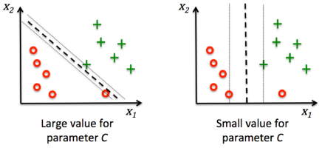
Effect of Value of C (coefficient of slack variable)

Slide 23
Soft Margin Classification Mathematically
The old formulation:
The new formulation incorporating slack variables:
Parameter C can be viewed as a way to control overfitting.
Find w and b such that
Φ(w) =½ w^{T}w is minimized and for all {(x_{i} ,y_{i})}
y_{i} (w^{T}x_{i} + b) ≥ 1
Find w and b such that
Φ(w) =½ w^{T}w + CΣξ_{i} is minimized and for all {(x_{i} ,y_{i})}
y_{i} (w^{T}x_{i} + b) ≥ 1- ξ_{i} and ξ_{i} ≥ 0 for all i

Slide 24
Soft Margin Classification – Solution
The dual problem for soft margin classification:
Neither slack variables ξ_{i} nor their Lagrange multipliers appear in the dual problem!
Again, x_{i} with non-zero α_{i} will be support vectors.
Solution to the dual problem is:
Find α₁…α_{N} such that
Q(α) =Σα_{i} - ½ΣΣα_{i}α_{j}y_{i}y_{j}x_{i}^{T}x_{j} is maximized and
(1) Σα_{i}y_{i} = 0
(2) 0 ≤ α_{i} ≤ C for all α_{i}
But neither w nor b are needed explicitly for classification!
w =Σα_{i}y_{i}x_{i}
b= y_{k}(1- ξ_{k}) - w^{T}x_{k} where k = argmax α_{k}
k
f(x) = Σα_{i}y_{i}x_{i}^{T}x + b

Slide 25
Soft V/s Hard Margin SVM
Soft-Margin always have a solution
Soft-Margin is more robust to outliers – Smoother surfaces (in the non-linear case)
Hard-Margin does not require to guess the cost parameter (requires no parameters at all)

Slide 26
Linear SVMs: Overview
The classifier is a separating hyperplane.
Most “important” training points are support vectors; they define the hyperplane.
Quadratic optimization algorithms can identify which training points x_{i} are support vectors with non-zero Lagrangian multipliers α_{i}.
Both in the dual formulation of the problem and in the solution training points appear only inside inner products:
Find α₁…α_{N} such that
Q(α) =Σα_{i} - ½ΣΣα_{i}α_{j}y_{i}y_{j}x_{i}^{T}x_{j} is maximized and
(1) Σα_{i}y_{i} = 0
(2) 0 ≤ α_{i} ≤ C for all α_{i}
f(x) = Σα_{i}y_{i}x_{i}^{T}x + b

Slide 27
Non Linear SVM
This allows the algorithm to fit the maximum-margin hyperplane in a transformed feature space.
The transformation may be non-linear and the transformed space high dimensionalthus though the classifier is a hyperplane in the high-dimensional feature space, it may be non-linear in the original input space.

Slide 28
Non-linear SVMs
Datasets that are linearly separable with some noise work out great:
But what are we going to do if the dataset is just too hard?
How about… mapping data to a higher-dimensional space:
0
x
0
x
x²
0
x

Slide 29
Nonlinear Classification

Slide 30
Non-linear SVMs: Feature spaces
General idea: the original feature space can always be mapped to some higher-dimensional feature space where the training set is separable:
Φ: x → φ(x)

Slide 31
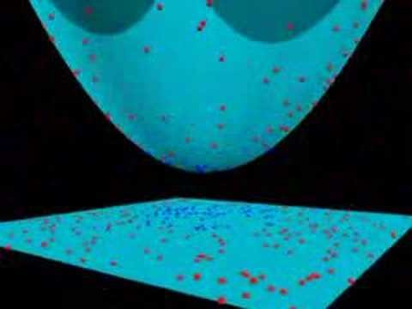

Slide 32
Kernels
We may use Kernel functions to implicitly map to a new feature space
Kernel fn:
Kernel must be equivalent to an inner product in some feature space

Slide 33
Example Kernels
Linear:
Polynomial:
Gaussian:

Slide 34
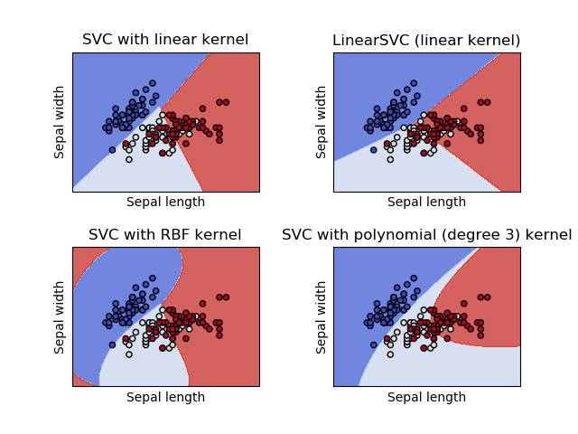

Slide 35
Non-linear SVMs Mathematically
Dual problem formulation:
The solution is:
Optimization techniques for finding α_{i}’s remain the same!
Find α₁…α_{N} such that
Q(α) =Σα_{i} - ½ΣΣα_{i}α_{j}y_{i}y_{j}K(x_{i}, x_{j}) is maximized and
(1) Σα_{i}y_{i} = 0
(2) α_{i} ≥ 0 for all α_{i}
f(x) = Σα_{i}y_{i}K(x_{i}, x_{j})+ b

Slide 36
Neural Network V/s Support Vector Machines
Neural Networks | Support Vector Machines
Hidden Layers map to lower dimensional spaces Search space has multiple local minima Training is expensive Classification extremely efficient Requires number of hidden units and layers Very good accuracy in typical domains | Kernel maps to a very-high dimensional space Search space has a unique minimum Training is extremely efficient Classification extremely efficient Kernel and cost the two parameters to select Very good accuracy in typical domains Extremely robust

Slide 37

SVM Extensions
Regression
Variable Selection
Boosting
Density Estimation
Unsupervised Learning
Novelty/Outlier Detection
Feature Detection
Clustering

Slide 38
Applications of Support Vector Machine
Speech Recognition
Data Base Marketing
Quark Flavors in High Energy Physics
Dynamic Object Recognition
Knock Detection in Engines
Protein Sequence Problem
Text Categorization
Breast Cancer Diagnosis
Cancer Tissue classification
Translation initiation site recognition in DNA
Protein fold recognition

Slide 39
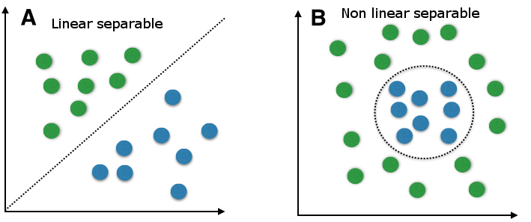
Support Vector Machine For Classification - SVC

Slide 40
Social Network Ads Dataset
It’s a dataset which tells whether users purchased or not purchased a particular product.
Contains columns like UserID, Gender, Age, EstimatedSalary and Purchased.
Last column is a label and is a categorical variable.

Slide 41
Importing libraries
import pandas as pd
import numpy as np
import matplotlib.pyplot as plt

Slide 42
Importing Dataset
dataset = pd.read_csv('Social_Network_Ads.csv’)
X = dataset.iloc[:,2:4]
y= dataset.iloc[:,-1]

Slide 43
Splitting dataset into Training Set & Test Set
from sklearn.model_selection import train_test_split
X_train, X_test, y_train, y_test = train_test_split(X, y, test_size = 0.25, random_state = 0)

Slide 44
Feature Scaling
from sklearn.preprocessing import StandardScaler
sc = StandardScaler()
X_train = sc.fit_transform(X_train)
X_test = sc.transform(X_test)

Slide 45
Fitting the classifier into the training set
from sklearn.svm import SVC
classifier = SVC(kernel = 'linear', random_state = 0)
Or
classifier = SVC(kernel = 'rbf', random_state = 0) classifier.fit(X_train, y_train)

Slide 46
Confusion Matrix
from sklearn.metrics import confusion_matrix
cm = confusion_matrix(y_test, y_pred)

Slide 47
K Fold Cross Validation
from sklearn import model_selection
from sklearn.model_selection import cross_val_score
kfold = model_selection.KFold(n_splits=10, random_state=7)
modelCV = SVC(kernel = 'linear', random_state = 0)
results = model_selection.cross_val_score(modelCV, X_train, y_train, cv=kfold, scoring=‘accuracy’)
print("10-fold cross validation average accuracy: %.3f" % (results.mean()))

Slide 48
Prediction
y_pred = classifier.predict(X_test)

Slide 49
Evaluating Classification Report
from sklearn.metrics import classification_report
print(classification_report(y_test, y_pred))

Slide 50
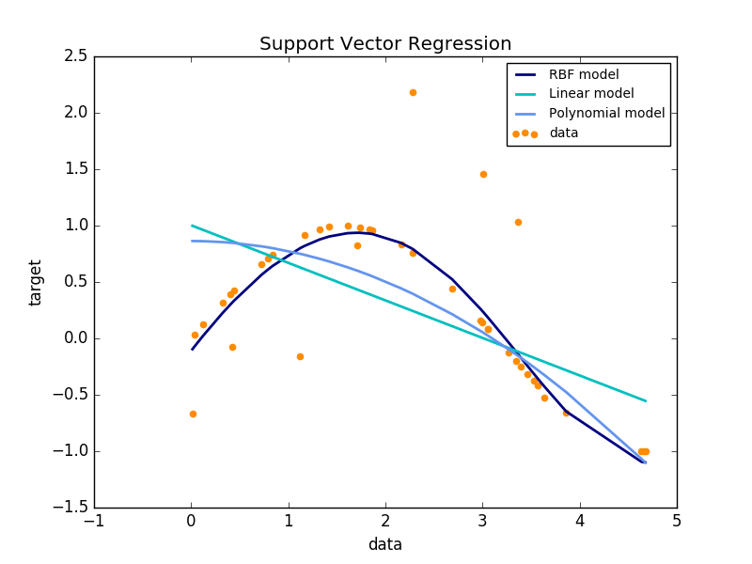
Support Vector Machine For Regression - SVR
SVR does not include the feature scaling as some of the linear regression models from sklearn
So do perform feature scaling separately

Slide 51
Positional Salary Dataset
The Dataset contains salary of 10 positions with level mentioned.
We have to fit a regression model using Support Vector Machine.

Slide 52
Importing libraries
import pandas as pd
import numpy as np
import matplotlib.pyplot as plt

Slide 53
Importing Dataset
dataset = pd.read_csv(‘Position_salaries.csv’)
X = dataset.iloc[:,1:2]
y= dataset.iloc[:,2:3]

Slide 54
Feature Scaling
from sklearn.preprocessing import StandardScaler
sc_X = StandardScaler()
sc_y = StandardScaler()
X = sc_X.fit_transform(X)
y = sc_y.fit_transform(y)

Slide 55
Support Vector Regressor
from sklearn.svm import SVR
regressor = SVR(kernel='rbf’)
model = regressor.fit(X,y)

Slide 56
Plotting
plt.scatter(X, y, color = 'red’)
plt.plot(X, regressor.predict(X), color = 'blue’)
plt.title('Truth or Bluff (SVR)’)
plt.xlabel('Position level’)
plt.ylabel('Salary’)
plt.show()

Slide 57
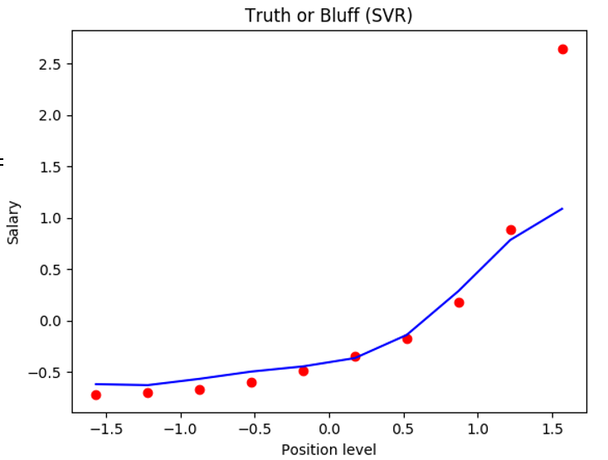
Plotting

Slide 58
Thank you
Stay tuned for practicing SVM with exciting Datasets

